Slide 1
"Smart" Recovery Monitoring and Support for SUD Continuing Care
John J. Curtin, PhD
Department of Psychology
University of Wisconsin - Madison

Slide 2

No disclosures to report
Notes:
To start, I have no disclosures to report. However, I do want to begin by telling you a bit about how I became interested in the program of research I am presenting to you today

Slide 3
Notes:
About a decade ago I was approaching the middle of my career. I had developed a successful basic clinical science research program as a psychophysiologist running experiments to understand the effects of drugs and drug withdrawal on stress. The work was intellectually stimulating, we were publishing it in good outlets, and we were getting grants, but my heart was increasingly not in it.

Slide 4
Notes:
I’d become a clinical psychologist to help people struggling with alcohol and other SUDs.
My paternal grandmother died of complications secondary to alcoholism.
My dad has struggled with his use of alcohol for his entire adult life and during periods where he lost control it affected all of us.
My cousin, Stephen, has a severe substance use disorder and has been incarcerated several times for drug related offenses. He has had periods of stability but they have always ended in another relapse.

Slide 5
Notes:
My Aunt Cathy and Stephen’s brother, Colin, had reached out to me on numerous occasions to ask what could be done to help Stephen.
And it was those conversations that really got me thinking about how I could re-direct my research program to help people like Stephen and my dad and my grandmother.

Slide 6

Precision Mental Health for Continuing Care
Notes:
It was around that time that my colleague, Dave Gustafson, reached out to me. Dave directs a center at UW that develops digital therapeutics for substance use disorders. These are essentially smartphone apps that provide ongoing continuing care for patients during their recovery. He had just completed a large randomized controlled trial demonstrating that his app meaningfully decreased heavy drinking days and increased abstinence rates over the first year of recovery.
However, he also noticed many of the people who had relapsed hadn't used the app in the days leading up to that relapse. And others who had relapsed hadn't used the specific supports in the app that he would have thought would be most effective for them.

Slide 7
Precision Mental Health for Continuing Care
“Could you predict not only who might be at greatest risk for relapse … … but precisely when that relapse might occur … … and how best to intervene to prevent it?"
Notes:
Dave knew that we were exploring the factors that motivated alcohol and other drug use and he asked us a simple question:
"Could you predict not only who might be at greatest risk for relapse but precisely when that relapse might occur and how best to intervene to prevent it"
... because if we could develop a system to do this, he could embed it into his app to guide people to the most effective supports at the most critical moments in their recovery

Slide 8
Precision Mental Health for Continuing Care
Precision mental health requires us to provide the right interventions and supports to the right people at the right time, every time.
SUD continuing care requires long-term monitoring and ongoing lifestyle adjustments and support to prevent relapse
Notes:
These questions that Dave was asking are at the heart of what we now call precision mental health. How can we provide the **right interventions and supports** to the **right people** at the **right time**, **every time**
And this focus on the **right time** is particularly important for recovery from substance use disorders. Substance use disorders are chronic relapsing conditions and therefore successful recovery requires lifelong monitoring and support to prevent relapse.
And, critically, the optimal supports for any specific individual can change month to month, day to day, and even from moment to moment.

Slide 9
Precision Mental Health for Continuing Care
Precision mental health requires us to provide the right interventions and supports to the right people at the right time, every time.
SUD continuing care requires long-term monitoring and ongoing lifestyle adjustments and support to prevent relapse
A "Smart" Recovery Monitoring and Support System can provide temporally precise, dynamic, personalized continuing care by combining:
Sensing
Artificial Intelligence/Machine learning
Notes:
We believed that we could harness and combine two technologies that were emerging at that time,
personal sensing and artificial intelligence algorithms,
to develop a smart recovery monitoring and support system that could both predict lapses before they occurred and provide personalized support and recommendations to patients about how to prevent those lapses from occurring.
And what I'd like to do today is tell you a bit more about how we are doing this, what we have learned so far, and where we are going next with this system

Slide 10
Personal Sensing
Personal sensing collects information from smartphones to identify a person’s thoughts, feelings, behaviors, and context.
Sensing allows for “real-world” measurement that
Can be sustained for long periods
Has very high temporal granularity
Notes:
First of all, lets talk briefly about the personal sensing inputs to our system.
Personal sensing is just a fancy term for methods that allow us to do real-world measurement of people’s thoughts, feelings, behaviors, and context.
These methods allow us to feasibly collect these inputs over very long periods of time from months to even years.
and we can collect these inputs with very high temporal granularity, at least several times per day and in some instances continuously

Slide 11
Personal Sensing
Personal sensing collects information from smartphones to identify a person’s thoughts, feelings, behaviors, and context.
Sensing allows for “real-world” measurement that
Can be sustained for long periods
Has very high temporal granularity
We focus on
Ecological Momentary Assessment (EMA)
Geolocation
Smartphone communications (calls and texts)
Notes:
At this point, we have worked extensively with a sensing method called ecological momentary assessment, or EMA for short,
but I will also tell you about how we are expanding our sensing methods to include geolocation and smartphone communications data.

Slide 12

Lapse Prediction for AUD
151 individuals with moderate to severe alcohol use disorder (AUD)
Early in recovery (1-8 weeks)
Committed to abstinence throughout study
Followed with sensing for up to 3 months
Ecological Momentary Assessment (EMA)
Geolocation
Smartphone Communications
Notes:
As the first step toward developing this system, in 2020 we completed data collection from a sample of individuals in early recovery from moderate to severe AUD.
We had followed these individuals for up to three months, using our three sensing methods and also recording any lapses back to alcohol use.

Slide 13
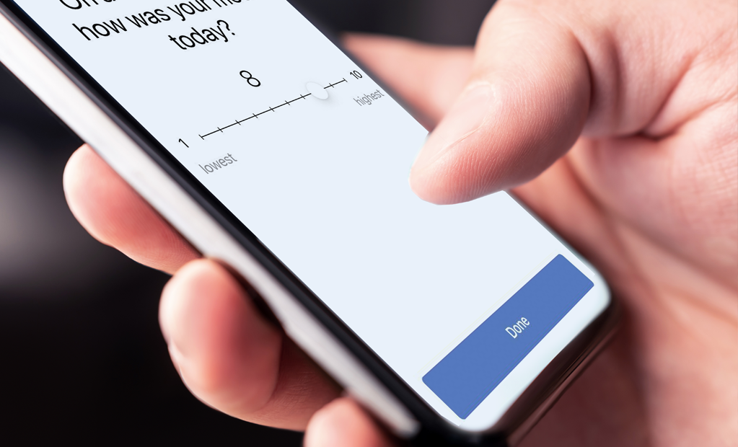
Ecological Momentary Assessment (EMA)
Current/Recent Experiences
Craving
Affect
Recent past alcohol use
Recent risky situations
Recent stressful events
Recent pleasant event
Future Expectations
Risky situations
Stressful events
Abstinence Confidence
Notes:
The first machine learning prediction models we developed from these data used features from EMAs so let me tell you a bit more about this method.
These EMAs are brief surveys that participants completed on their smartphones. They take 20-30 seconds to complete and we collected them several times per day.
Participants used these EMAs to report on their current experiences including their craving, affect, and recent alcohol use. And they also let us know about future expected important events in the coming week and their confidence that they could remain abstinent.

Slide 14
Model Predictions
Predict hour-by-hour probability of future lapse
Lapse window widths
Next week
Next day
Next hour
Notes:
We used features from these EMAs to train machine learning models that make predictions about the hour-by-hour probability of a future lapse.
And we developed separate models for three future lapse windows – lapses in the next week, lapses in the next day, and lapses in the next hour.

Slide 15
Model Predictions
Predict hour-by-hour probability of future lapse
Lapse window widths
Next week
Next day
Next hour
Notes:
For example, if I was in recovery, I could use these models to generate the probability that I would lapse after this symposium ends. The next week model would generate the probability I would lapse at some point between 4 pm today and 4 pm next Sunday, the next day model would predict the probability that I would lapse between 4 pm today and 4 pm tomorrow and the most temporally precise next hour model would provide the probability that I would lapse between 4 pm today and 5 pm today.
And of course, all of the models would only use data collected prior to 4 pm today so that they are “predicting”, in the full sense of the word, into the future and not just demonstrating an association.

Slide 16
Model Performance
The Area under the Receiver Operating Characteristic Curve (auROC) indicates the probability that a true lapse is scored higher than a true no-lapse
Random performance: auROC = 0.5
Perfect performance: auROC = 1.0
Rules of thumb for auROC
.70 - .80 is considered fair .80 - .90 is considered good >= .90 is considered excellent
Notes:
We can evaluate the performance accuracy of these models using a metric called the auROC for short.
An auROC of .5 indicates a model whose accuracy is no better than random guessing, and
An auROC of 1.0 indicates perfect accuracy
And models with auROCs of .90 or higher are considered to have excellent performance.

Slide 17
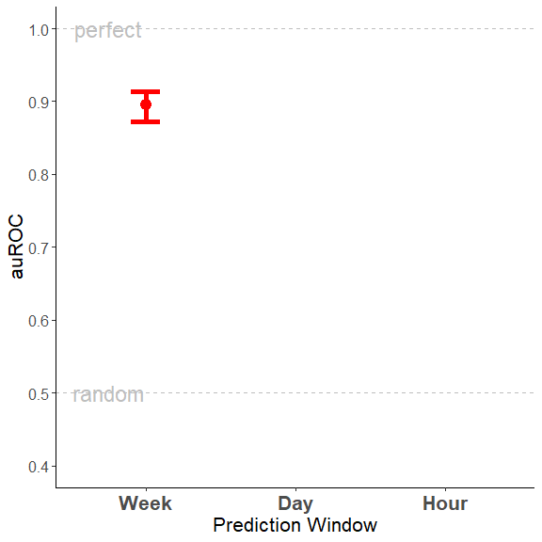
Model Performance
Rules of thumb for auROC
.70 - .80 is considered fair .80 - .90 is considered good >= .90 is considered excellent
Notes:
[PAUSE]
So given this, we were very encouraged to see that our one week prediction model had excellent performance with an auROC of approximately .90.

Slide 18
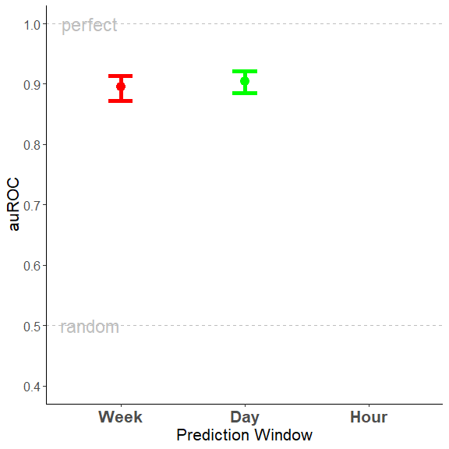
Model Performance
Rules of thumb for auROC
.70 - .80 is considered fair .80 - .90 is considered good >= .90 is considered excellent
Notes:
[PAUSE]
And our model that made predictions about the lapse probability in the next day performed even better.
[PAUSE]

Slide 19
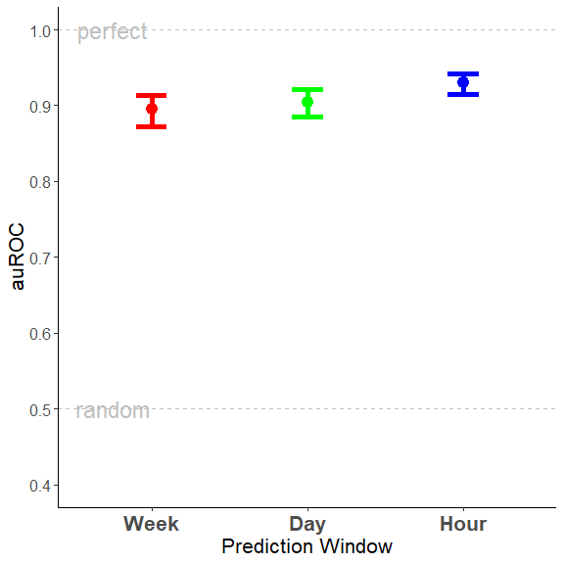
Model Performance
Rules of thumb for auROC
.70 - .80 is considered fair .80 - .90 is considered good >= .90 is considered excellent
Notes:
and our one hour model had the highest performance of all with an auROC of 0.93.
Candidly, we hadn’t anticipated that we could do this well with such high levels of temporal precision.
But we can, and to be clear, we believe all three of these models to have clinically implementable levels of performance such that we can use them to make meaningful decisions for individual participants at specific moments in time.

Slide 20
Personalized Recommendations
Notes:
But we can get much more than just lapse probabilities from these models.
Using a tool from the field of interpretable AI, SHAP values, we can understand which features contributed most strongly to any prediction for a specific person at a specific moment in time. This allows us to understand not only WHEN a lapse might occur but also WHY and potentially how best to intervene.

Slide 21
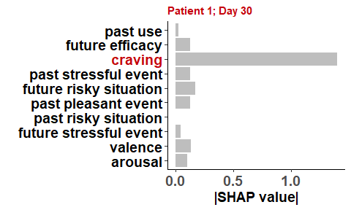
Personalized Recommendations
Notes:
For example, in this first plot, I am showing you someone who would be predicted to have a high lapse probability on day 30 of their recovery because they have been reporting high craving.
For this person, we could recommend urge surfing techniques or remind them that distracting activities can help get them through short periods of craving.

Slide 22
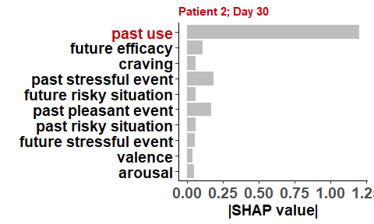
Personalized Recommendations
Notes:
In contrast, a second person might have similarly high lapse probability on day 30 of their recovery, but instead because they have lapsed a few times in recent weeks.
They could be encouraged and assisted to complete activities designed to increase their motivation for abstinence.

Slide 23
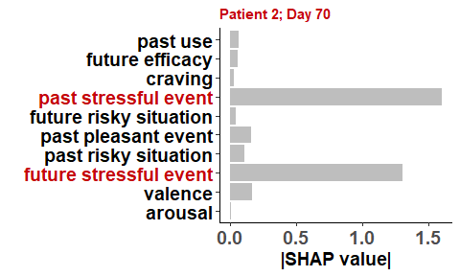
Personalized Recommendations
Notes:
And at a later point in time, that same person may have improved their abstinence motivation but now be at increased risk for a lapse because of a string of recent past and anticipated stressors.
Now they could be provided with guided stress reduction or relaxation techniques that they could use each day.
In this way, we can provide personalized recommendations to patients that are tailored to their unique risk profile at that moment in time.

Slide 24

Optimize and Evaluate Personalized Support
Sensing EMA and geolocation for six months
Model updated each night for next day
Lapse probability predictions
Important risk features
Risk relevant support recommendations
Participants receive daily messages varying combinations of these components
Measure trust, engagement, and clinical outcomes
Notes:
And we have just received another grant from the NIAAA to do just this.
In this project, we will use a day level prediction model with inputs from both EMA and geolocation. We will use this model to make
daily lapse probability predictions for each participant
Identify their current personalized lapse risks,
and map those risks to behavioral and support recommendations that are specific to each person each day.
We can then manipulate what information we include in daily messages from the system to participants to increase their trust and engagement with the system as well as formally evaluating its clinical benefits.
We are super excited to start this project and I'm happy to talk more about it during the discussion period.

Slide 25
Lagged Predictions
Notes:
OK, so the models I've been describing to you so far are all focused on making predictions about lapses in the immediate future, like the next day. We think the day level model is ideally suited to guide people to adjust their behavior each day and deploy tools they learned in previous treatment to support their recovery.
But sometimes, people need supports that aren't immediately available that day. Maybe they need to schedule a follow-up with their therapist for additional aftercare, or meet with their AA sponsor or with a supportive friend. These activities can take time to set up so we have begun to experiment with making lagged predictions further into the future.

Slide 26
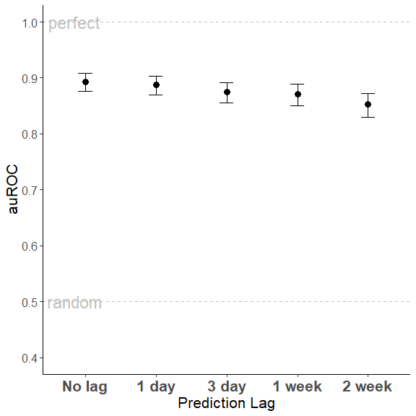
Lagged Predictions
Notes:
And we have been encouraged to see that when we lag our predictions so that the prediction window doesn’t start immediately but instead starts one day or three days or even up to 2 weeks in the future, we can still predict lapses quite well.
To be clear, there is a significant time effect as expected, with performance degrading as we predict further into the future. But, even with lags of up to two weeks, we can still predict lapses with auROCs of .85.
Unfortunately, we couldn't train models with lags longer than 2 weeks because these participants were only tracked for up to 3 months and we lose too much data if we lag the models further than that. But as I will describe in a moment, we are about to complete data collection on another sample that we tracked for up to a year and we are eager to evaluate longer lags with those data.

Slide 27
Algorithmic Fairness
Notes:
PAUSE
So, obviously, we are really excited about the potential capabilities of a system that includes both next day and lagged predictions for providing personalized continuing care.
But not surprisingly, there are still a number of very important issues to address and I want to dive in a bit deeper into one of the most important ones.

Slide 28
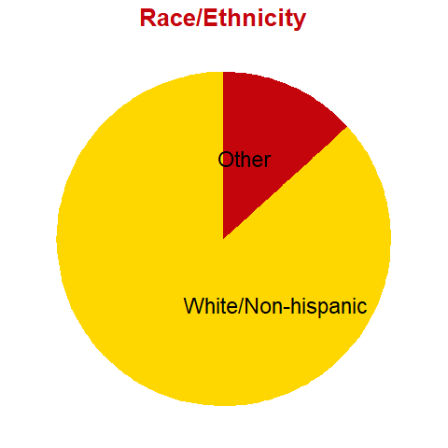
Algorithmic Fairness
Notes:
Before we could ever broadly implement our monitoring and support system, we must assure that the models in our system are fair when used with individuals from different subgroups that have historically been disadvantaged in mental healthcare.
As one example of this issue, the data we collected to train these models from this first NIAAA grant did not include much racial and ethnic diversity among the participants. We collected those data at a time when we weren't yet thinking as carefully about issues of representation as we try to do now.

Slide 29
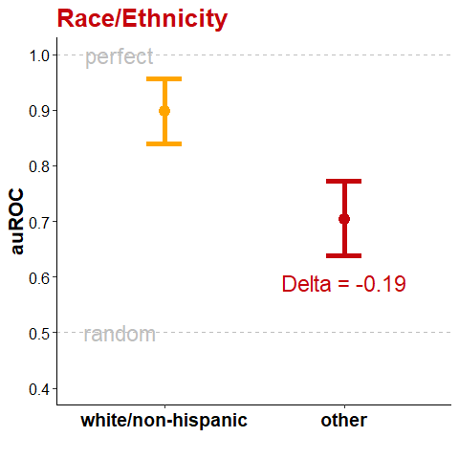
Algorithmic Fairness
Notes:
Given that, we were dismayed but not surprised to find that those models perform substantially worse (with auROCs that are .19 units lower) when predicting lapses for anyone who wasn’t white and non-hispanic.

Slide 30
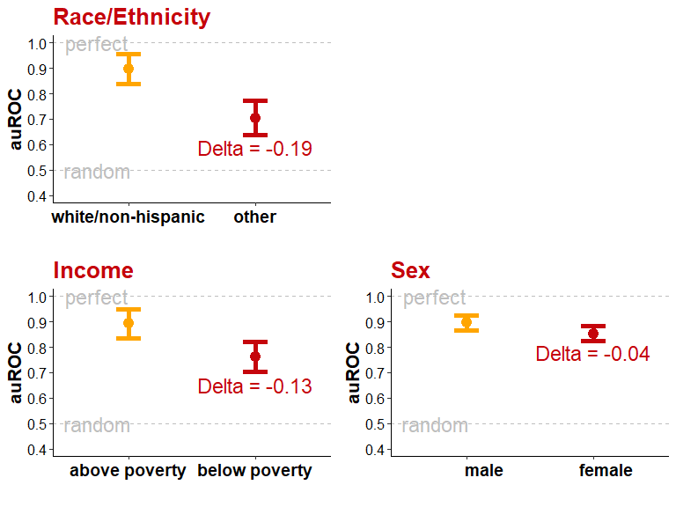
Algorithmic Fairness
Notes:
And these fairness issues were not limited to just race and ethnicity. We see worse performance for participants with incomes below the poverty line and to a lessor extent for female participants.
This is obviously unacceptable and we are working now to correct this.

Slide 31

Algorithmic Fairness
NIDA funded project is recruiting ~ 400 patients in recovery from Opioid Use Disorder
National sample (size; diversity: demographics, location)
More variation in stage of recovery (1 – 6 months at start)
Sensing for 12 months
* Data collection will finish in December 2024
Notes:
For example, we will complete data collection at the end of this month for a NIDA funded project that has collected a more racially diverse sample using nationwide recruiting techniques.
This sample also includes much needed geographic diversity because the factors that predict lapse in urban settings may be different from those that predict lapse in rural settings.

Slide 32
Algorithmic Fairness
Excellent performance: auROC ~ 0.94
Notes:
In advance of this meeting, we've begun to train models using EMA features from this new dataset.
I should note that in this project, we only administered EMAs once per day to reduce measurement burden given that we tracked participants for up to a full year.
And we are excited to see that even with only 1 EMA per day, we are now getting the best performance we have seen to date when predicting lapses in the next day.
An auROC of .94

Slide 33
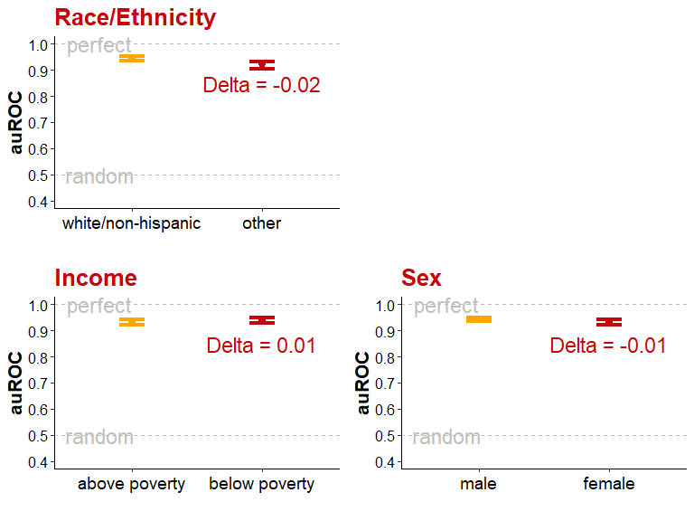
Algorithmic Fairness
Excellent performance: auROC ~ 0.94
Improved fairness
Notes:
And much more importantly, this next day prediction model appears much fairer with respect to its performance in all three of the subgroups where our original models were deficient.
PAUSE
But let me explicitly say that issues related to fairness and the potential to exacerbate health disparities through the use of a sensing and AI based monitoring and support system are much more complicated than what I've had time to present here.
I’d be happy to dive a bit deeper into this during the discussion period if people are interested to engage more with this.

Slide 34
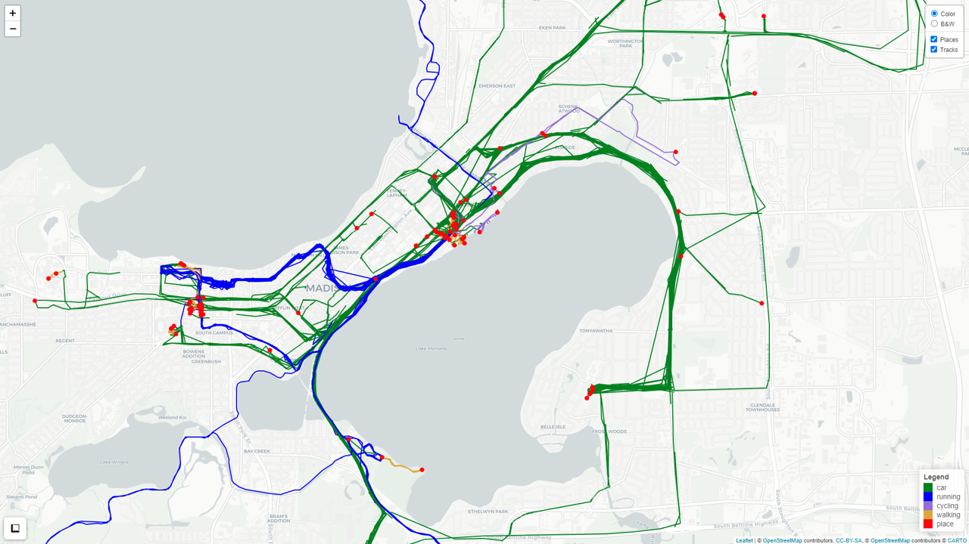
Geolocation Features
Notes:
PAUSE
I'd like to end by taking a moment to talk about the use of geolocation for lapse prediction while looking at some of my location data from a few years ago.
As I mentioned earlier, we have started building models that use both geolocation and EMA to predict lapses and plan to implement one of these models for daily use in our new NIAAA project.
Our interest in using geolocation features is not primarily to increase model performance. My sense is that we are close to the ceiling with respect to how well our models can predict future lapses – at least with respect to the next day

Slide 35
Geolocation Features
Notes:
Instead, we are looking for a broader set of features that measure risk factors that either people can't report about accurately by EMA or that we simply can't ask about while also keeping the EMAs short to reduce measurement burden.
With geolocation data, we can quantify the time spent at risky and protective locations. Visits to treatment centers and AA meetings. Visits to the gym or other fitness facilities. Time at the home of supportive friends and family. Time at bars, or visit to liquor stores or the homes of drinking buddies. We can tell when they are at work and when they are on vacation. We can see if someone is isolating at home or starting to go out more frequently in the later evenings.

Slide 36
Geolocation Features
Notes:
All of this and more is present in peoples timestamped movement patterns and in the places they stop to visit frequently.
In our preliminary analyses, many of these features have proven important for prediction generally or at specific points in time for specific individuals. And I think the face validity of these features alone can give you a clear sense of how we might use them to recommend lifestyle adjustments when they emerge as person specific predictors of lapse risk.
Of course, I am also happy to talk more about geolocation and how we contextualize it to get more power from this signal during the discussion period.
Thanks for your time. And lets move on now to questions about what you've heard from all of us today.

